Slide 1
α-catenin structure and nanoscale dynamics
in solution and in complex with F-actin
Zimei Bu
City College of New York
May, 2019

Slide 2
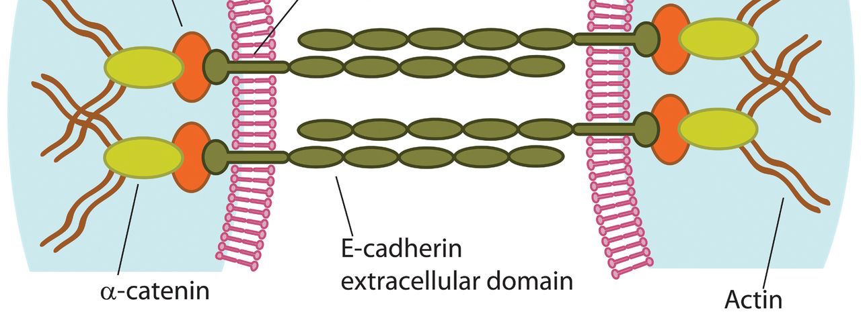
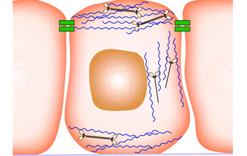
Adherens junction complex in cell-cell adhesion Transmits mechanical stress from cell to cell
tissue integrity and remodeling
embryo morphogenesis
mechanosensor

Slide 3
SEC-SAXS analysis of α-catenin dimer and monomer
Size Exclusion Chromatography - Small Angle X-ray Scattering
SSRL
Stanford Synchrotron Radiation Laboratory
Notes:
Figure 1. Alpha-catenin and SEC-SAXS analysis. (A) Primary structure and domains in alpha-catenin. (B) SEC-UV of alpha-catenin. The fractions at elution volume 10.9 ml and 12.5 ml have molecular mass of xx and xx g/mol, respectively, as measured by static light scattering. (C) SEC-SAXS of the dimer and monomer peaks. (D) SEC-SAXS of the dimer peak. (E) SEC-SAXS of the monomer peak. Note: because (E) used a different SEC column from (C) and (D), the peak positions are shifted. The arrows in (D) and (E) marked the fractions of SAXS data selected for further analysis as shown Fig. 2 .

Slide 4
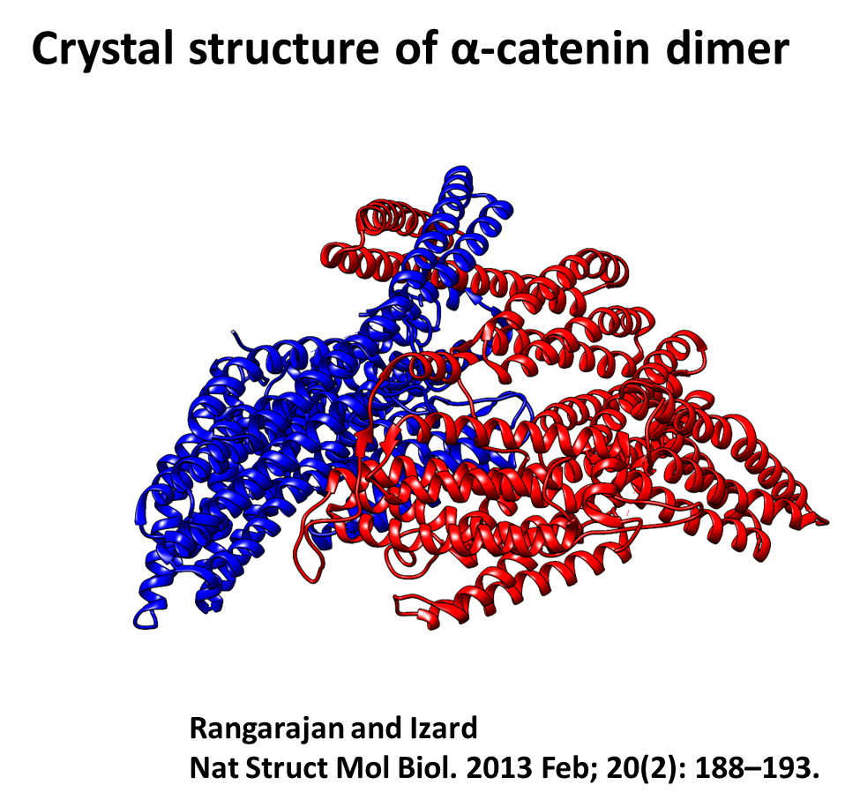
Comparing P(r) for solution α-catenin
monomer and dimer to the crystal structures
Monomer
Dimer
Notes:
Figure 2. (A) SEC-SAXS of the dimer (black) and monomer fractions (red). (B) P(r)s of dimer and monomer calculated from SAXS data. (C) Comparing P(r) of the SEC-SAXS monomer fraction (red open circle) with that calculated from crystal structure (one of the 4IGG protomers) after the disordered regions were reconstructed (red line). (D) Comparing P(r) of the SEC-SAXS dimer fraction (black open circle) with that calculated from crystal structure (PDB: 4IGG) after the disordered regions were reconstructed in the PDB file (black line).

Slide 5
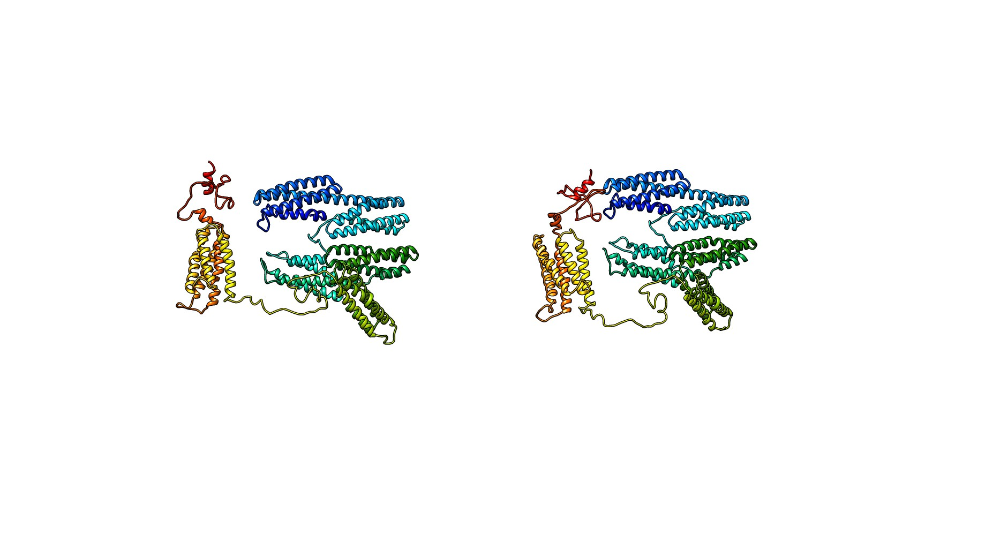
Alpha-catenin monomer in solution
Notes:
Figure 3. Solution structures of alpha-catenin monomer . (A) Structural models generated from SASSIE Monte Carlo simulation with best fit to the monomer fraction of experimental SEC-SAXS data (green and blue lines), with chi²<0.98. (B) Chi square of the fits of generated models to the monomer SEC-SAXS data. (C) Two structural models of open and closed alpha-catenin monomer with best fit to the experimental SAXS data.

Slide 6
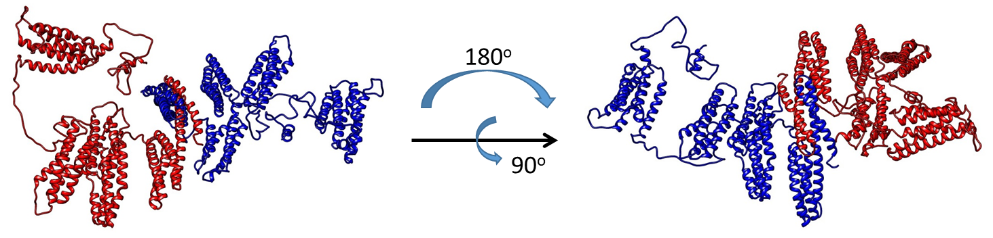
Alpha-catenin dimer in solution
Notes:
Figure 4. Solution structure of alpha-catenin dimer. (A) A representative structural model generated from SASSIE Monte Carlo simulation with best fit to the dimer fraction of SEC-SAXS data (red line) with Chi²<1.21. (B) Chi square of the fits of generated models to the dimer SEC-SAXS data. Two rounds of simulations are performed in order to minimize the Chi. (C) A representative alpha-catenin dimer with minimized chi square.

Slide 7
Small Angle Neutron Scattering
SANS + contrast variation
100% D₂O buffer
Hydrogenated mouse
+ Deuterated cat
Notes:
Figure 6. (A) Contrast-matched SANS on the ^{d}alpha-catenin·F-actin complex in 100% D2O buffer at the matching point of ^{d}alpha-catenin. The three panels are the scattering of the complex at different Actin to ^{d}alphacatenin molar ratios, with distinct correlation peak appears at molar ratio=3.8. The actin concentration is kept at 81.5 microM in all three panels. (B) The structure factor S(Q) of the F-actin bundle, generated by normalizing the I(Q) at molar ratio =3.8 (bottom panel) by the I(Q) at molar ratio=15.1 (top panel). (C) EM image of alpha-catenin assembled F-acitn bundle. (D) a structural model of alpha-catenin dimer between two actin filament.

Slide 8
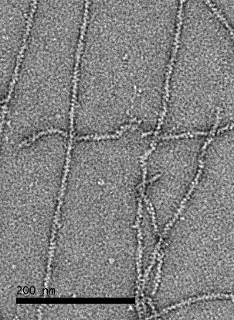
Interaction of α-catenin with actin filaments
Contrast-matching SANS – deuterated α-catenin
with hydrogenated actin filament

Slide 9
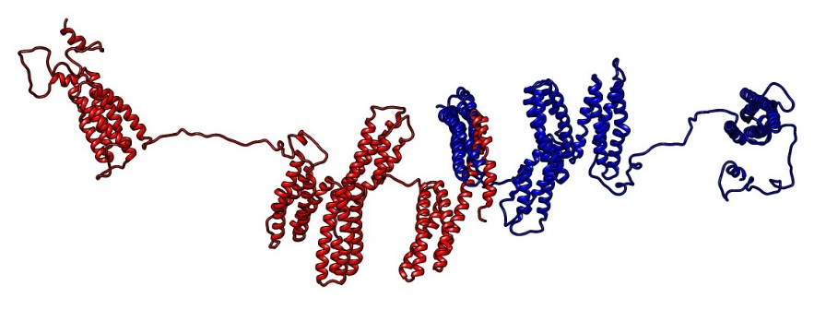
Contrast-match SANS - ^{d}α-catenin/F-actin complex 40% D₂O
Notes:
Figure 5. (A) Contrast-matched SANS on the ^{d}alpha-catenin·F-actin complex in 40% D2O buffer at the matching point of F-actin (black filled square). The red line is the fit of the structural model shown in (D). The concentration of ^{d}alpha-catenin is about 1.74 mg/ml. The concentration of actin is about 5 mg/ml. The actin:dalpha-catenin molar ratio is 6.8:1. (B) P(r) of the complex in 40% D2O, which corresponds to the conformational of ^{d}alpha-catenin (filled black square) as compared to alpha-catenin dimer in solution from SEC-SAXS (open square). (C) Chi² of the fit of SASSIE Monte Carlo generated structures to the SANS data in 40% D2O buffer. (D) a representative structural model with that fit to the experimental SANS data with chi2<0.9.

Slide 10
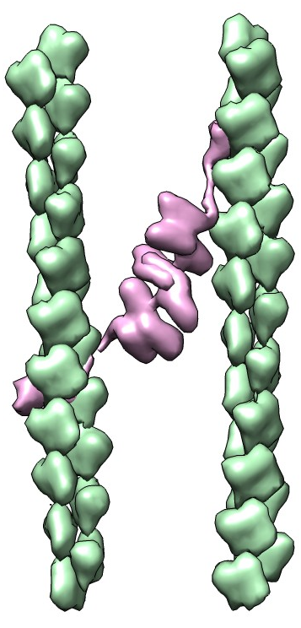
Contrast variation SANS α-catenin/F-actin complex—100% D2O
B
A
C
~180 Å
Notes:
Figure 6. (A) Contrast-matched SANS on the ^{d}alpha-catenin·F-actin complex in 100% D2O buffer at the matching point of ^{d}alpha-catenin. The three panels are the scattering of the complex at different Actin to ^{d}alphacatenin molar ratios, with distinct correlation peak appears at molar ratio=3.8. The actin concentration is kept at 81.5 microM in all three panels. (B) The structure factor S(Q) of the F-actin bundle, generated by normalizing the I(Q) at molar ratio =3.8 (bottom panel) by the I(Q) at molar ratio=15.1 (top panel). (C) EM image of alpha-catenin assembled F-acitn bundle. (D) a structural model of alpha-catenin dimer between two actin filament.

Slide 11
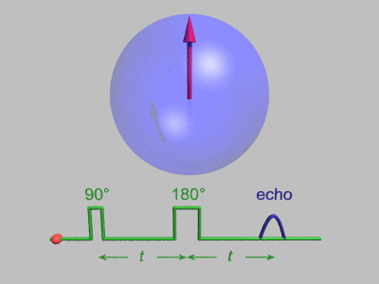
Neutron Spin Echo spectroscopy (NSE)
reveals protein nanoscale dynamics
Bloch sphere

Slide 12
Neutron spin echo spectroscopy
NSE spectra of a protein
Nanosecond to microsecond time scales
10-1000 Å: nano length scales—nanoscale motion
Farago et al, Biophys J., 2010

Slide 13
Neutron spin echo spectroscopy
Decay rate of NSE spectra and
effective diffusion constant D_{eff}(Q)

Slide 14
Neutron spin echo spectroscopy
Our theoretical framework allows us to see nanoscale
internal motion
Mobility tensor H defines domain dynamics
Bu et al, PNAS, 2005
Farago et al, Biophys. J., 2010

Slide 15
Neutron spin echo spectroscopy
D_{eff}(Q) measured by NSE and the mobility tensor
Can easily calculate D_{eff}(Q) if we know:
structure + diffusion constant D_{o} + domain boundaries
NO multi-parameter curve fitting
NO large scale simulations or network models
Allows us to test models of mobility tensor, which defines internal nanoscale dynamics

Slide 16
NSE spectra of alpha-catenin
Notes:
Figure 7. Neutron spin echo spectroscopy of alpha-catenin dimer. Top panel: (A)-(C) intermediate correlation function I(Q,t)/I(Q,0) as a function of fourier time at different Q values. (D) Effective diffusion constant Deff(Q) (black square) obtained from 1st cumulant fit of the spectra shown in (A)-(C). Solid red line is the theoretical Deff(Q) using the coordinates of alpha-catenin dimer shown in Figure 4C, assuming the alpha-catenin dimer is a rigid body. Dashed red line is theoretical Deff(Q) assuming a.a. 836-906 in the dimer are moving.

Slide 17
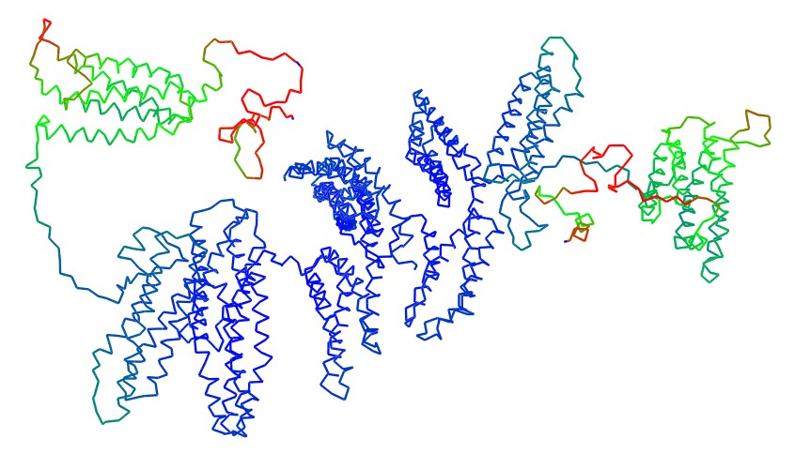
Neutron spin echo spectroscopy allows us to see
Nanoscale motion of the disordered tail of alpha-catenin
Nicholl et al, Biophys. J. In press.

Slide 18
Summary
Structure of α-catenin dimer and monomer in solution
α-catenin in complex with actin filament
Nanoscale dynamics of the actin binding tail
Neutron Spin Echo spectroscopy (now we see with NSE!)

Slide 19



Acknowledgements
David J E Callaway
Iain D Nicholl
Bela Farago
Collaborators:
Tsutomu Matsui
Thomas Weiss
William Heller
Chris Stanley
Shuo Qian
Funding: NIH NIDDK (with Peter Friedman, Pittsburgh)
NSF (MCB Molecular Biophysics)
Beam time awards (DOE BES)

Slide 20
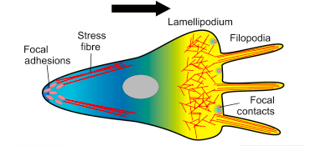
α-catenin in polarized cell migration
modulates actin cytoskeleton dynamics

Slide 21
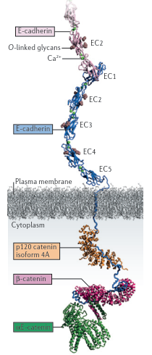
Structure of the adherens junction complex
Mechanosensor
Masatoshi Takeichi, Nature Reviews|Molecular Cell Biology, 2014

Slide 22


NSE—Quasielastic neutron scattering probes dynamic fluctuations
Neutrons change energy after interacting with a sample
E_{f}
$$\overset{⃑}{k}f$$
$\overset{⃑}{k}$_{i}
θ
E_{i}
Elastic scattering— structure
Inelastic and quasielastic scattering— dynamics and motion

Slide 23
Structure of the adherens junction complex
Mechanosensor
Masatoshi Takeichi, Nature Reviews|Molecular Cell Biology, 2014

Slide 24
1
149
260
276
395
505
628
681
836
906
N1
M1
ABD
N2
M2
M3

Slide 25
Interaction of α-catenin with actin filament
Deuterated α-catenin
Hydrogenated F-actin

